Slide 1

Natural Language Processing Course Natural Language Toolkit
Ivo Bernardo – Udemy Course

Slide 2

Natural Language Toolkit (NLTK)
First release: 2001
Developed by: Department of Computer and Information Science at the University of Pennsylvania
Highlights: POS Tagging, Tokenization, Stemming, Lemmatization

Slide 3
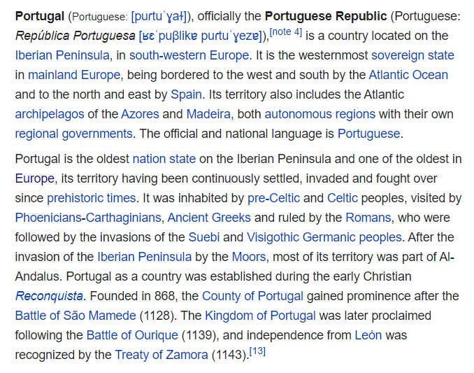

Natural Language Toolkit (Sentence Tokenization)
Sentence 1
Sentence 2
PunktSentenceTokenizer
Sentence n

Slide 4
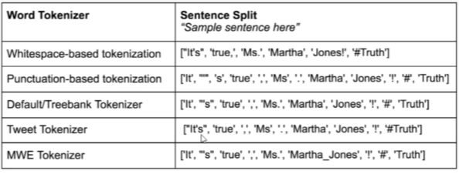
Natural Language Toolkit (Word Tokenization)
Word 1
Word 2
Word m

Slide 5
Natural Language Toolkit (Stemming)
Stemming is a text normalization technique that helps you to reduce words into similar prefixes:
Examples of stemming:
Creating -> creat
Creation -> creat
Create-> creat
Porter
Snowball
Lancaster
Reduces your Vocabulary
Lose information
Aggressiveness
Saves Space
https://towardsdatascience.com/stemming-corpus-with-nltk-7a6a6d02d3e5?sk=56861bf1e269a60404874fcf86837c0f

Slide 6
Natural Language Toolkit (Lemmatization)
Lemmatization is a text normalization technique that helps you to reduce words into the root of the word:
Examples of lemmatization:
Is -> be
Are -> be
Be -> be
Reduces your Vocabulary
Lose information
Saves Space
Needs Part of Speech

Slide 7
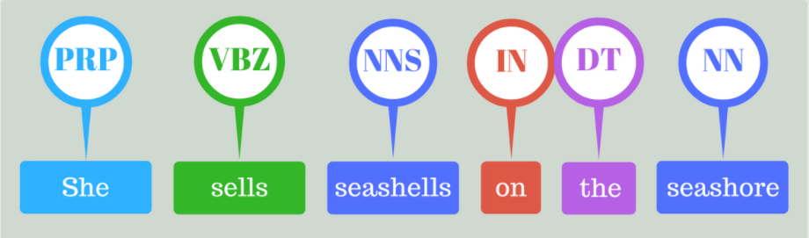
Natural Language Toolkit (POS Tag)
Part of speech tag relates to the function of a word in a text:
PRP – Personal Pronoun
VBZ – Verb, Present Tense
NNS – Plural Noun
IN – Preposition
DT – Determinant
NN – Singular Noun

Slide 8
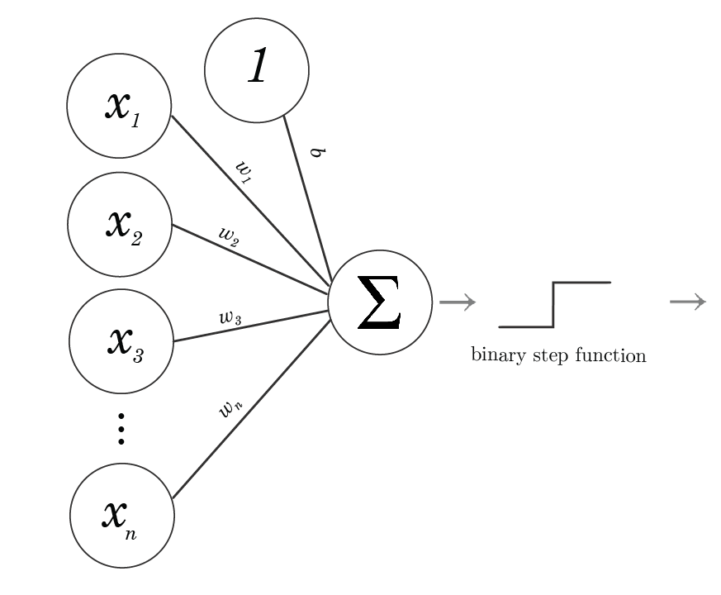
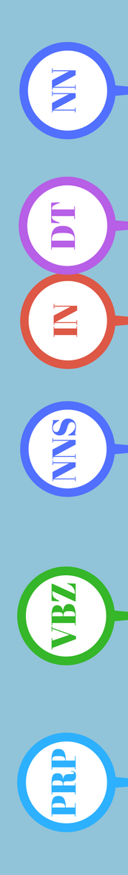
Natural Language Toolkit (POS Tag)
We will use a pre-trained model from NLTK – (based on a simple perceptron):
Pre-Trained Model

Slide 9


Natural Language Toolkit (POS Tag)
Train our own probabilistic model – Using unigrams:
Verb
Verb
2/3 -> 66.6%
Noun
He used to nail that concept
1/3 -> 33.3%
Verb
It’s easy to nail the idea
New sentences to tag!
I broke a nail
Noun
I was able to nail the experiment
Verb
Tagged corpus!
I painted a nail
Verb

Slide 10
Natural Language Toolkit (POS Tag)
Train our own probabilistic model – Using Bi-Grams with fallback:
Verb
Verb
2/2 -> 100%
Noun
He used to nail that concept
1/1 -> 100%
Verb
It’s easy to nail the idea
New sentences to tag!
I broke a nail
Noun
I was able to nail the experiment
Verb
Tagged corpus!
I painted a nail
Noun

Slide 11
Natural Language Toolkit (POS Tag)
Measuring performance - accuracy:
6/10 -> 60%

Slide 12
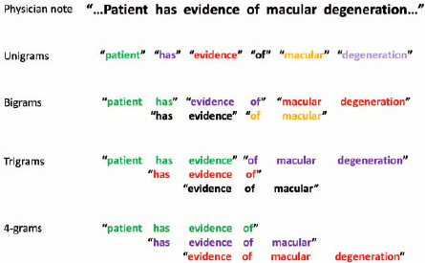
Natural Language Toolkit (N-Grams)
Example of N-Grams:
Credit: https://www.researchgate.net/figure/An-example-of-unigrams-bigrams-trigrams-and-4-grams-extracted-from-the-clinical-phrase_fig1_271910222

